Slide 1
Anomaly Detection and Prediction in Weather
Funny Mud Pee
Ziyuan(Peter) Ye, Jiayi Deng, Yu-Chih (Wisdom) Chen

Slide 2
Agenda
Problem Statement
Project Purpose
Methodology
Result
Modeling Results
Conclusions & Recommendations

Slide 3
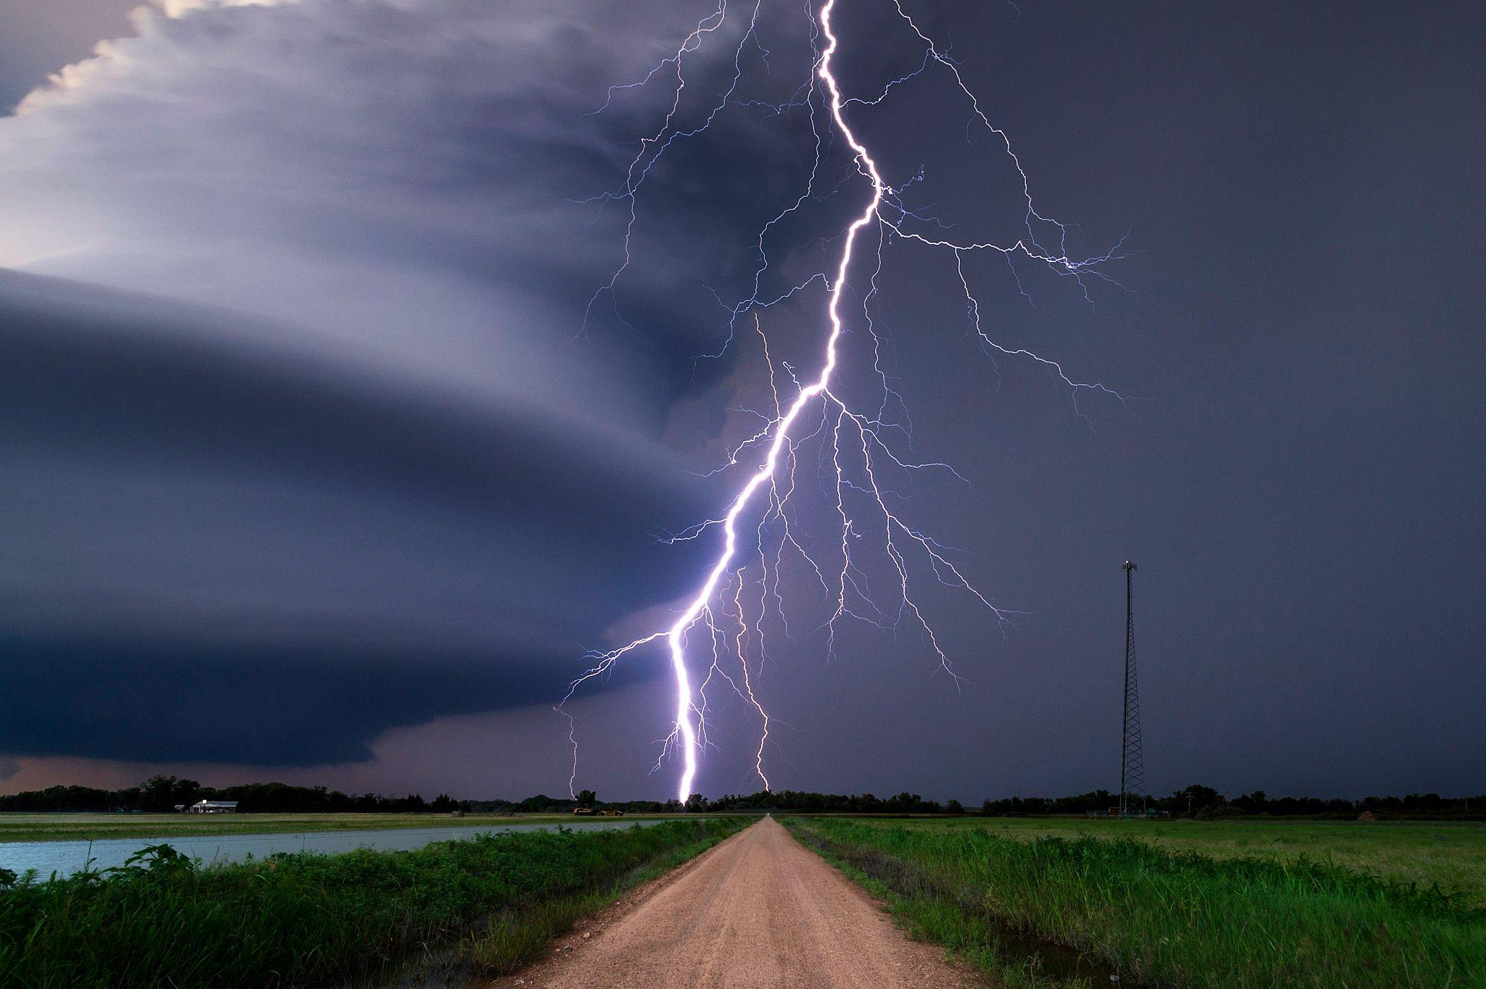

Problem Statement
Context: Sudden and severe changes in weather conditions often greatly affect sectors like agriculture, cultivation, transportation, etc.
Goal: Design a system to detect and analyze anomalies in weather data to predict sudden and severe changes in weather conditions.

Slide 4
Project Purpose
Anomaly Detection
The system will utilize statistical models to identify inconsistencies and abnormalities in weather data, including parameters like temperature, relative humidity, and dewpoint.
Real-Time Visualization:
Our system will feature a user-friendly interface displaying real-time weather data and anomaly threshold. Data points exceeding these thresholds are identified as anomalies.
Autocorrection Over Time:
The system is designed to refine and optimize its performance over time using an Exponential Decay Weighted Score mechanism.

Slide 5
Project Purpose - Data Set Description
Location
Coordinates (Latitude & Longitude)
Summary (Temperature summary)
Temperature
Units (Temperature Units → F)
Daytime (False → Night)
Dewpoint (Temperature to which air must be cooled to become saturated with water vapor)
Probability of Precipitation (Likelihood of precipitation occurring at a specific location)
Relative Humidity (Measure of the amount of moisture)
Wind Speed (Speed of the Wind → mph)
Start (Weather changes of the start time)
End (Weather changes of the end time)
End - Start → Time windows feature (Windows Size → 3)

Slide 6
Methodology - Tools
01
pyensign
pandas
numpy
River
exponential decay weighting
Backend
02
html
javascript
plotly
Frontend
03
pyensign
Flask
socketio
Connection

Slide 7
Methodology - Framework
Weather Publisher
Weather Subscriber
Score Publisher
Score Subscriber
Weighted Score Publisher
Weighted Score Publisher
Insert Latitude and Longitude
Ping API from NOAA
Fetch future nearly 7*24 weather data
Subtract useful features
Publish each data to Weather topic
Subscribe to Weather topic
Feature engineering and transformation
Train the Model
Get an anomaly score
Publish each original weather data plus the score to Score topic
Subscribe to Score topic
Store the score in cache
Retrieve the cache and weighting each time point scores
Publish each original weather data plus the weighted score to weighted score topic
Subscribe to Weighted score topic
Emit the original weather data and weighted score to dashboard
Check whether the time point exists, if it exists, update it with the new one

Slide 8
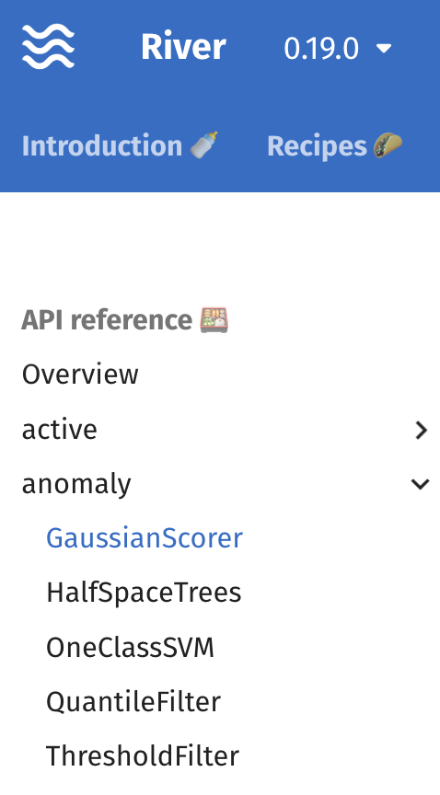
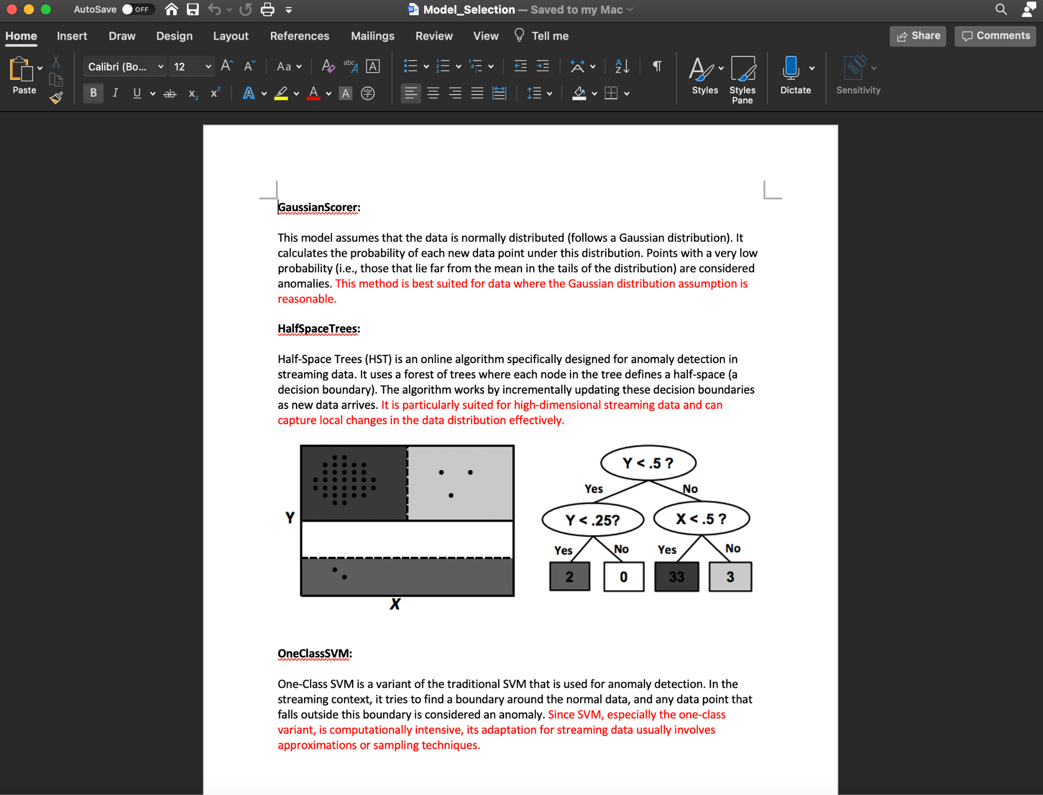
Methodology - Model Justification
Half
SpcaceTrees

Slide 9
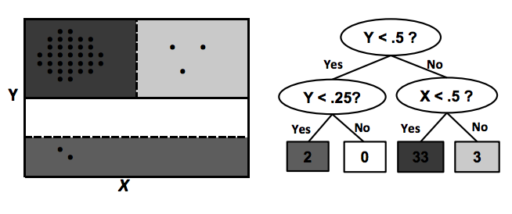
Methodology - Model Description
Half Space Tree
Used for anomaly detection in data streams
Partition the data space into several windows and make predictions based on the number of data points in each window
Depth h is a full binary tree consisting of 2^(h+1) - 1 nodes, in which all leaves are at the same depth, h

Slide 10
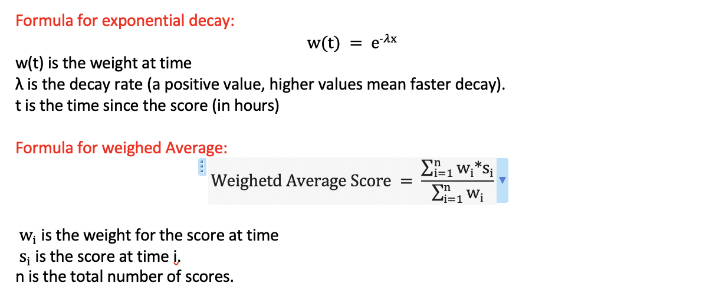
Methodology - Feature Engineering and Transformation
Feature Transformation
Conversion of 'daytime' from boolean to numerical: True/False converted to 1/0.
Conversion of 'windSpeed' to numerical: Extracts the numerical part from a string representation.
Feature Engineering
LDA (Latent Dirichlet Allocation) on 'summary' field : The 'summary' column, which is likely a textual description, is transformed into two numerical components using LDA.
Min-Max Scaling: Scales the features based on Min-Max scaling, ensuring that the final features are in the range of [0,1]
Weighted Anomaly Score Calculation: model produces anomaly scores for each hour over a forecasted period of 7 days (168 hours).Need to be combined into a single score, especially with a time-based weightage (more recent scores are more meaningful because more recent weather forecasts are more precisely empirically.

Slide 11
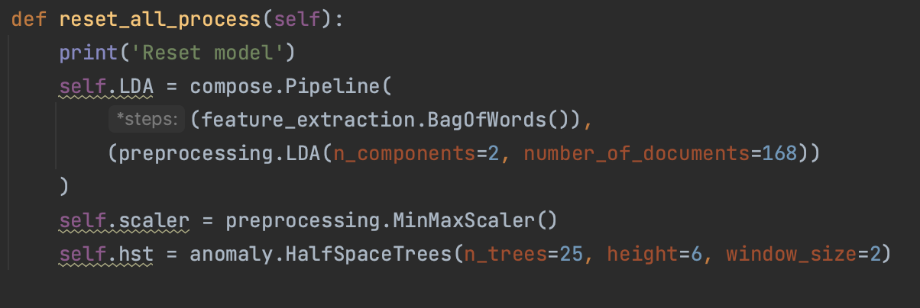
Methodology - Model Engineering
More trees = More opinions on what’s normal and what’s not.
A taller tree can look at data in more details but will make score sensitive.
Window_size:Number of recent weather data to decide if the new one is weird
n_trees, height, and window_size
For Hawaii
The parameters should depend on the weather data!
The weather pattern of the location

Slide 12
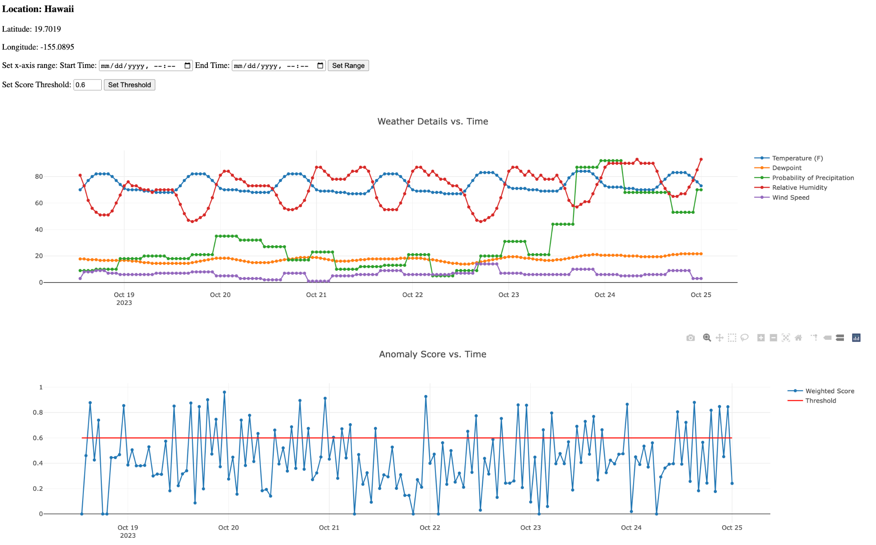
Methodology - Validation Methods
Dashboard Example
Since the weather anomaly detection is unsupervised, one of the effective way to validate is using graph. We use our frontend dashboard to display streaming weather details and score over time.
We scrutinizes each anomaly point and compare it with weather details to judge

Slide 13
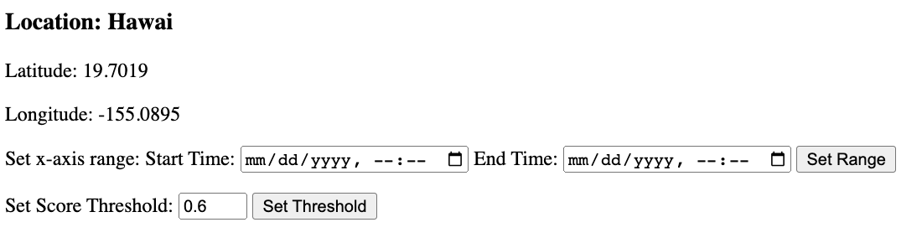
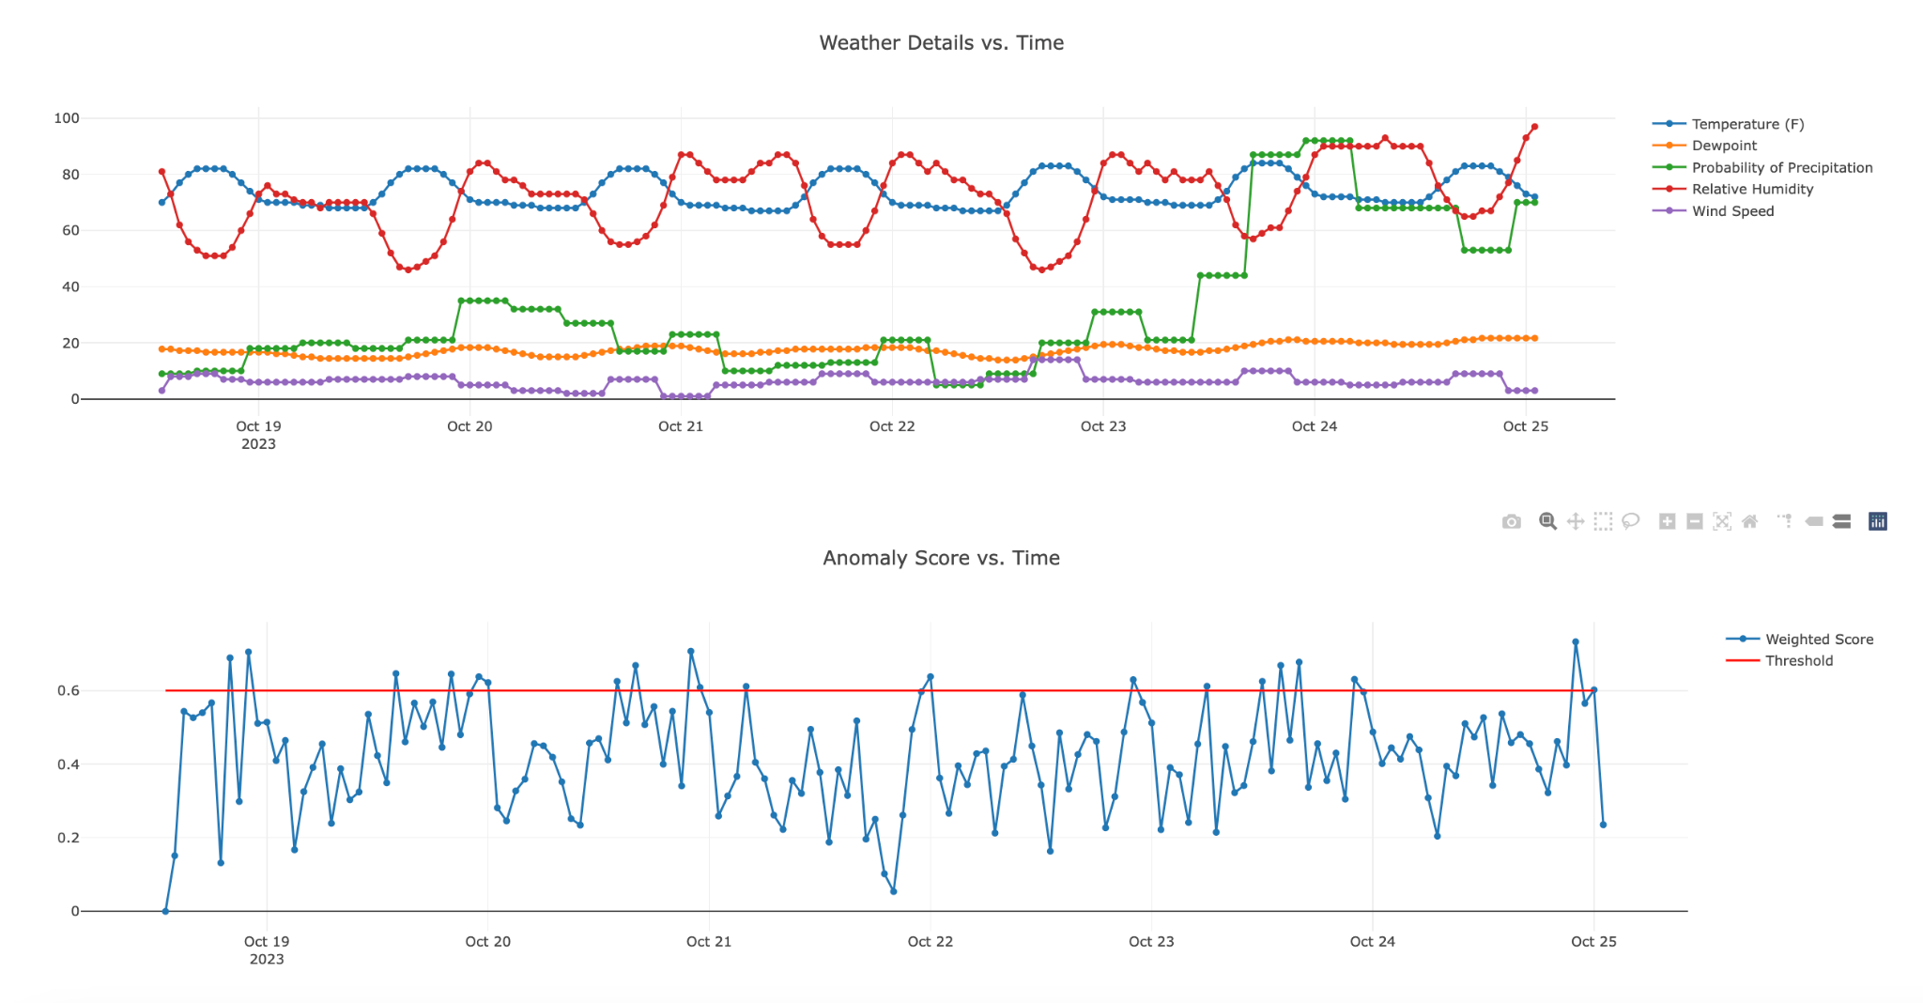
Methodology - Frontended
Using Flask and Socketio to emit the data once received
Using Javascript and Ploty to construct a simple dashboard on web in a local port
Showing location details and providing interacting tools to set time range and anomaly threshold based on user’s preference
Two graphs in one window
Auto updating and overriding plots if a new
weather detail or a weighted score comes
More interaction tools provided by Ploty

Slide 14
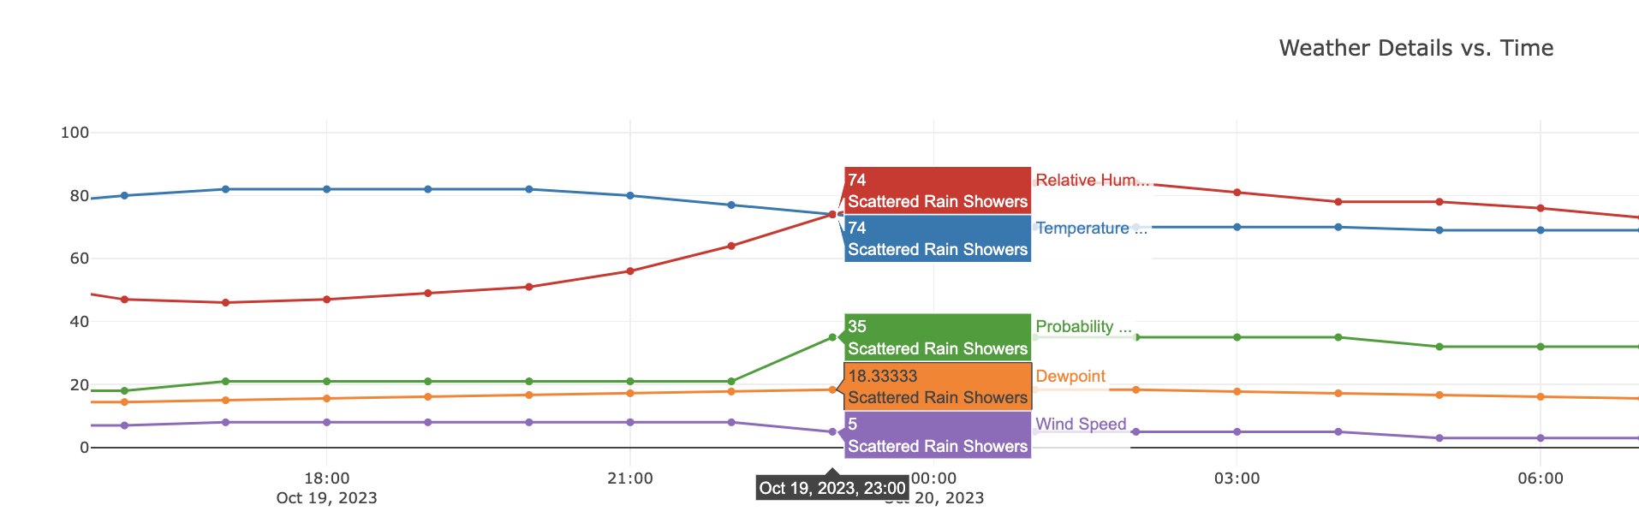
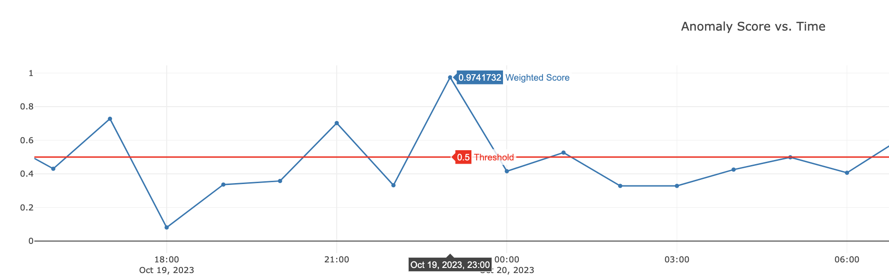
Modeling Result - Example A (Hawaii)
Several weather details change at 23:00 and the weighted score is around 0.97.

Slide 15
Conclusions & Recommendations
Actionable Recommendations
Find a way to update the parameters itself
We don’t have to find specific parameters for individual location based off its weather pattern
Outlines Limitations
Potential for false positives in anomaly detection for lack of labels
Effectiveness is constrained by timeliness of incoming data
Considerations for Next Steps
Refine the anomaly detection algorithms
Add searchable locations on the webpage
Proposed Future Extensions
Expand to global weather data
Customize alerts for different sectors
Integrate with IoT for real-time data collection and AI

Slide 16
Reference
River
https://riverml.xyz/0.19.0/
Pyensing
https://github.com/rotationalio/pyensign
Weather Data Playground
https://github.com/rotationalio/data-playground/tree/main/weather
Weather API
https://www.weather.gov/documentation/services-web-api

Slide 17
Thank you

